Slide 1
Evaluating User’s Viewing Behaviors with
Eye-Tracking and Heatmap
Dik Lun Lee

Slide 2
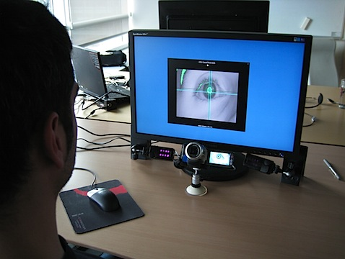
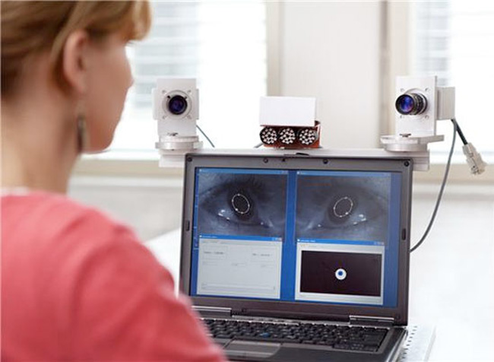
Eye Tracking Devices
Tracks eyeball movements (where you are looking at)
Fixation: 200-300 msec (how long you look at a place)
Other measurements: Saccades (quick movement, 40-50 msec) and pupil dilation, etc.
Human behavior study, games, etc.
Dik Lun Lee

Slide 3
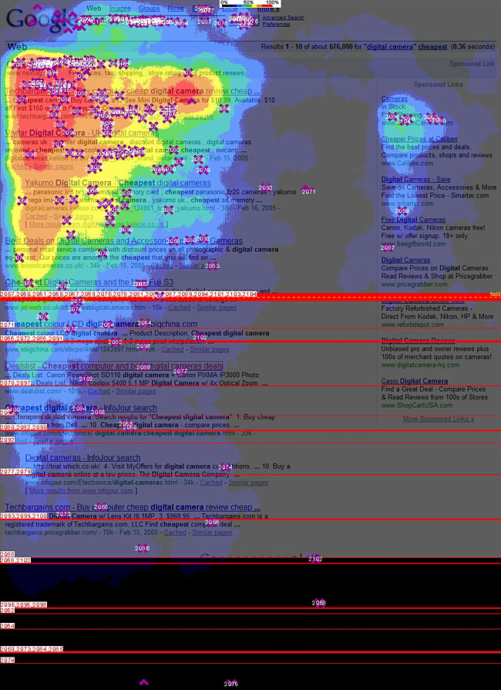
Eye-tracking Search Engine Usage
The golden triangle
Organic
Rank | Visibility
1 | 100%
2 | 100%
3 | 100%
4 | 85%
5 | 60%
6 | 50%
7 | 50%
8 | 30%
9 | 30%
10 | 20%
PPC
Rank | Visibility
1 | 50%
2 | 40%
3 | 30%
4 | 20%
5 | 10%
6 | 10%
7 | 10%
8 | 10%
PPC/Ads
Organic Results
Dik Lun Lee

Slide 4
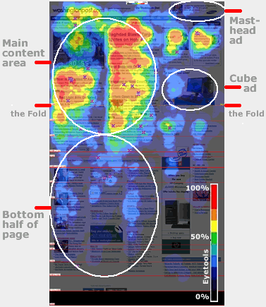
Eye Tracking for Optimizing Website Design
Washington Post
Dik Lun Lee

Slide 5
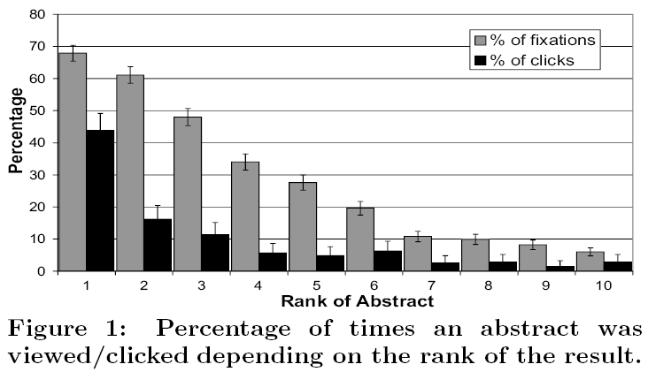
Observations
Users look at the first and second links at about the same frequency
But click on the first link much more frequently than the second link
Users believe in the first link more
Dik Lun Lee

Slide 6
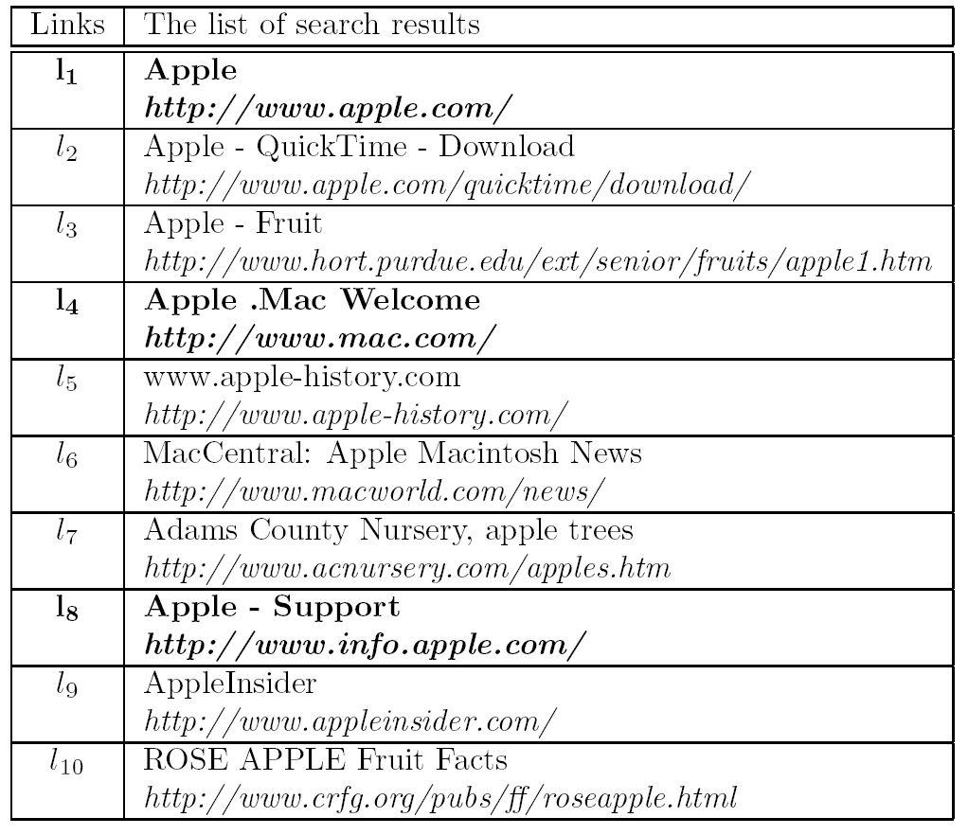
An Example of Clickthrough Data
clicked
Dik Lun Lee

Slide 7
Inferring Relevance from Clickthroughs
Assumption (a big one): Users read (the summary of) each of the results from top to bottom, click on relevant results and skip non-relevant results
E.g., the user clicks on #1, #4 and #8, the search engine can infer that
  #1, #4 and #8 are relevant
  #2, #3, #5, #6 and #7 are non-relevant
It cannot infer if #9 and #10 are relevant or not since it is not sure if the user has examined the items below the last click
Result list:
Apple Store √
Apple - QuickTime
Apple - Fruit
Apple .Mac √
www.applehistory.com
Adam Country Nursery
Apple cookbook
Apple Support √
… …
… …
Question: Is it too strong an assumption to say that pages not clicked by the user are non-relevant to the query?
Dik Lun Lee

Slide 8
Inferring Preferences from Clickthroughs
Assumption (a big one): Users read (the summary of) each of the results from top to bottom, click on relevant results and skip non-relevant results
Preference inference: Instead of inferring a relevant vs non-relevant decision, it is possible to infer the user preference instead, i.e., user prefers
  #1 over #2, #3, #5, #6 and #7
  #4 over #2, #3, #5, #6 and #7
  #8 over #2, #3, #5, #6 and #7
  no further preference can be concluded since it is not sure if the user has examined the items below the last click
Result list:
Apple Store √
Apple - QuickTime
Apple - Fruit
Apple .Mac √
www.applehistory.com
Adam Country Nursery
Apple cookbook
Apple Support √
… …
… …
Dik Lun Lee

Slide 9
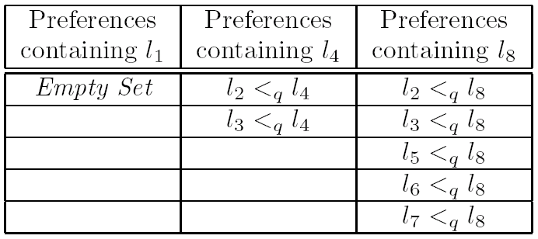
Preference Mining – Joachims Method
Assumption: users scan the results strictly from top to bottom (recall the eye-tracking experiment)
If user skips a page l_{i} and clicks on l_{j} which ranks lower than l_{i} , l_{i} <_{q} l_{j}
Penalize high ranking links
  no indication of l₁ being better than any other links => ranker makes no effort to preserve l₁ as a preferred link in the optimization process
  l₄ appears to be less favorable compared with l₈
Dik Lun Lee

Slide 10
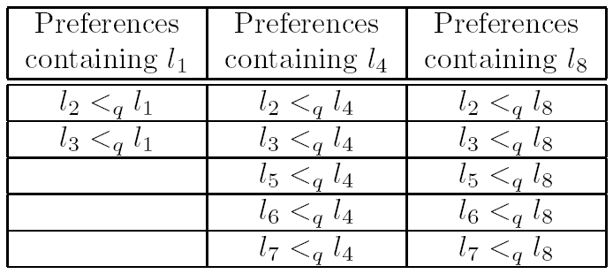
Preference Mining – mJoachims Algorithm
Augment some preferences to Joachims algorithm
  If l_{i} , l_{j} are clicked, and l_{k} is not clicked and is between l_{i} , l_{j} (i < k < j)
  Then mJoachims algorithm infers l_{k} <_{q} l_{i}
augmented
Dik Lun Lee

Slide 11
More Refined Preference Mining Strategies
Dik Lun Lee

Slide 12
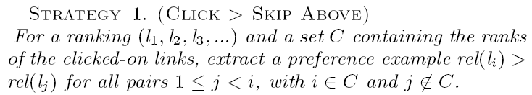
Strategy 1: Click > Skip Above
Takes trust bias and quality bias into account: Preferences are generated only when user decided not to trust the search engine and skip over a higher ranked link.
Since preferences are generated between links that users had examined, all feedback is relative to the quality of the retrieved set
Result: | l₁ | l₂ | l₃ | l₄ | l₅ | l₆ | l₇
Click (C) | √ |  | √ |  | √
Preferences: | l₃ > l₂ | l₅ > l₂ | l₅ > l₄
Dik Lun Lee

Slide 13
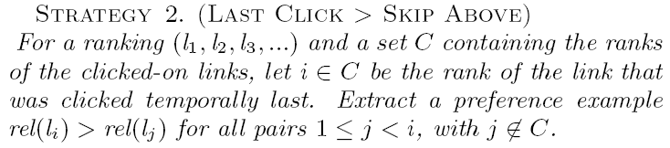
Strategy 2: Last Click > Skip Above
Earlier clicks might be less informed than later clicks (users clicks more and more carefully)
Result: | l₁ | l₂ | l₃ | l₄ | l₅ | l₆ | l₇
Click (C) | √ |  | √ |  | √
Last click is l₅
Preferences: | l₅ > l₂ | l₅ > l₄
Dik Lun Lee

Slide 14
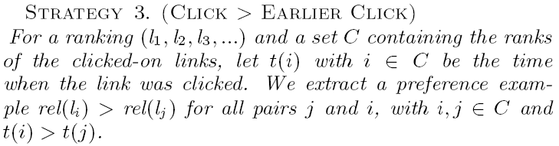
Strategy 3: Click > Earlier Click
Snippets clicked later are more relevant than earlier clicks
  Users would not click on more links if they are already satisfied with those clicked ones
Result: | l₁ | l₂ | l₃ | l₄ | l₅ | l₆ | l₇
Click (C) | √ |  | √ |  | √
Order of clicks: 3, 1, 5
Preferences: | l₁ > l₃ | l₅ > l₃ | l₅ > l₁
Dik Lun Lee

Slide 15
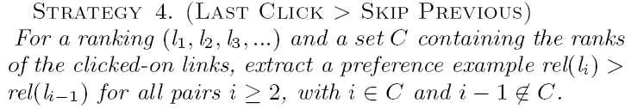
Strategy 4: Last Click > Skip Previous
Snippets that are most reliably evaluated by the user are those immediately above the clicked links.
  If a link is clicked but the link above is not clicked, than the link above must be judged to be irrelevant.
Result: | l₁ | l₂ | l₃ | l₄ | l₅ | l₆ | l₇
Click (C) | √ |  | √ |  | √
Preferences: | l₃ > l₂ | l₅ > l₄
Dik Lun Lee

Slide 16
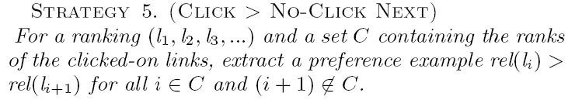
Strategy 5: Click > No-Click Next
When user clicks on a link, he/she might have already scanned the snippet below it
  If a link immediately below a clicked link is not clicked by the user, it is likely irrelevant.
Result: | l₁ | l₂ | l₃ | l₄ | l₅ | l₆ | l₇
Click (C) | √ |  | √ |  | √
Preferences: | l₁ > l₂ | l₃ > l₄ | l₅ > l₆
Dik Lun Lee

Slide 17
Take Home Messages
There are different strategies to interpret and translate human click behaviors into preference rules
Some strategies make stronger assumptions and are more restrictive than others
Eye tracking experimental evaluation indicates some interpretations are more accurate than others
No strategy is absolutely accurate as human behaviors do not follow rules
The strategies presented here are in no way exhaustive
Clickthrough data is more suitable for generating relative preferences than absolute preferences as a click is often affects by its own rank and other links present around it.
Dik Lun Lee

Slide 18
Search Engine Personalization
Dik Lun Lee

Slide 19




Why Search Engine Personalization?
Conventional search (Google, Yahoo, MSN Bing…etc):
  Results are ranked according to page’s importance on the web
  Return the same results to all users who ask the same query
In reality, different users have different interests in mind
Personalization: Adjust search result ranking based on user preferences
What are needed?
  Need to capture user interests
  Search engine needs to re-rank results according to user interests
Query = “apple”
Dik Lun Lee

Slide 20
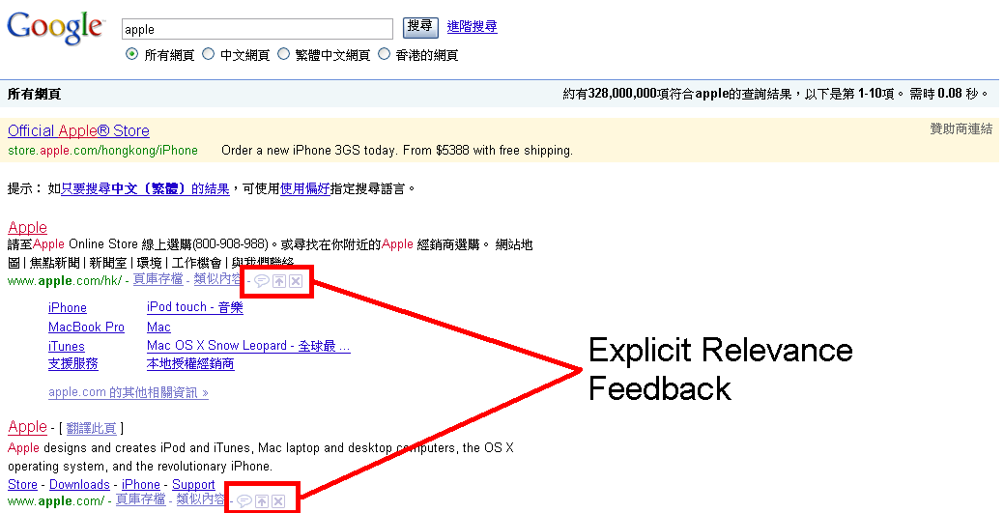
Implicit versus Explicit Feedback
Explicit:
  Users explicitly identify which documents are relevant and which are not relevant
  Problem: Users are usually reluctant to explicitly provide their preferences because extra manual efforts are involved
Dik Lun Lee

Slide 21
Implicit versus Explicit Feedback
Implicit:
  Search engine automatically learns and identifies which documents are relevant and which are not relevant
  No extra efforts are required from the users
  Most recent research focuses on automatically learning user preferences from:
    Clickthroughs
    Browsed Documents
Dik Lun Lee

Slide 22
Deriving User Interests with Clickthroughs
Dik Lun Lee

Slide 23
Search Engine without Clickthroughs
query
Search engine
http://www.cs.ust.hk/
http://www.hku.hk/
… …
www.cs.ust.hk
Web server
Search engine does not know which results have been clicked
user
Dik Lun Lee

Slide 24
Search Engine with Clickthroughs
query
Search engine
http://www.google.com/jsp?url=www.cs.ust.hk
http://www.google.com/jsp?url=www.hku.hk
… …
Clickthroughs:
“dik lee” www.cs.ust.hk 1
url forward
Web server
www.cs.ust.hk
Search engine knows which results have been clicked for a query, and the ranks of the clicked results
user
Dik Lun Lee

Slide 25
Clickthrough Data Format
Formally, a triplet (q, r, c)
  q – the input query (a set of keywords)
  r – the ranked list of returned search items
  c – the set of links a user clicked on, which conveys implicit user’s preference
Dik Lun Lee

Slide 26
Preference Mining
Link l_{i}
computer
iPod
iPhone
Link l_{j}
fruit
juice
farm
<_{q}
[computer,iPod,iPhone] <_{q} [fruit,juice,farm]
a_{i} | computer | iPod | iPhone | fruit | juice | farm | …
weight | -1 | -1 | -1 | 1 | 1 | 1 | 0
Dik Lun Lee

Slide 27
Personalizing the Ranking Function – Re-ranking
Recall ranking method (inner product) in vector-space model:
Document i ’s vector
wt_{i,1}
wt_{i,2}
wt_{i,3}
wt_{i,n-1}
wt_{i,n}
Regular search engine
*
*
*
*
*
Query
qt_{i,1}
qt_{i,2}
qt_{i,3}
qt_{i,n-1}
qt_{i,n}
a₁
a₂
a₃
a_{n-1}
a_{n}
Personal weight vector
+
Post-processing / re-ranking
Score
Personalized similarity score of document i depends on:
<wt_{i,1}, …, wt_{i,n}>, <qt_{i,1}, …, qt_{i,n}>, and <a₁, …, a_{n}>
The score (thus rank) of document i can be controlled by a₁ to a_{n}
Since re-ranking is typically applied to the top n documents returned by the regular ranking, the final result is restricted by the goodness of the first ranking
Dik Lun Lee

Slide 28
Personalization using Query Reformulation
Reformulate the query using the persona weight vector:
Query reformulation
Personal weight vector
a₁
a₂
a₃
a_{n-1}
a_{n}
+
+
+
+
+
Query
qt_{i,1}
qt_{i,2}
qt_{i,3}
qt_{i,n-1}
qt_{i,n}
Regular search engine
*
*
*
*
*
Document i ‘s
vector
wt_{i,1}
wt_{i,2}
wt_{i,3}
wt_{i,n-1}
wt_{i,n}
+
Score
More efficient than first ranking and then re-ranking with personal weight vector
Not restricted by the goodness of the regular ranking
Dik Lun Lee

Slide 29
Deriving User Interests from Browsed Documents
Dik Lun Lee

Slide 30
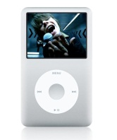
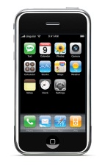


Mining Topical Interests from Browsed Documents
To model a user’s topical interests, the contents of the user’s browsed documents are explored
Keywords are extracted from the user’s browsed documents to model the users’ topical interests
The contents of the browsed documents are explored to derive a hierarchical user interest model as the user profile
Browsed
Documents
iPod
iPhone
iMac
Query = “apple”
Dik Lun Lee

Slide 31
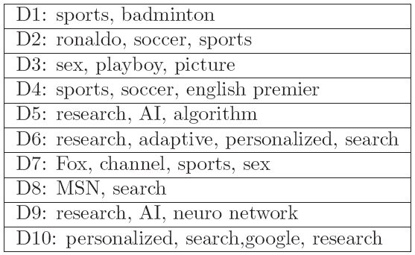
Building a Hierarchical User Profile
Automatically builds hierarchical user profiles
  Extract frequent terms from browsed documents
  Organize the extracted terms into hierarchical structure as the user profile
Assumptions
  Terms exist frequently in user's browsed documents represent topics that the user is interested in
  D(t) denotes all documents covered by a term t
  |D(t)| represents the number of documents covered by t
  Term t is frequent if |D(t)| > minSupport
Dik Lun Lee

Slide 32
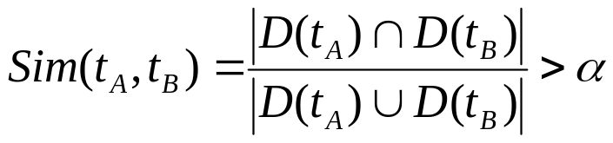

Building a Hierarchical User Profile
Proposition (Similar terms): Two terms, t_{A}, t_{B}, which cover similar document sets might indicate the same topical interest.
Propositon (Parent-Child terms): More specific terms t_{A} often appear with general t_{B} terms, while the reverse is not true.
  For example, more specific term “apple” tends to occur together with the general term “fruit”.
  On the other hand, the term “fruit” might also occur with terms, such as “grape”, “strawberry” or “orange”, not only with the term ”apple”.
  Thus, t_{A} is marked as child of t_{B} if
Dik Lun Lee

Slide 33
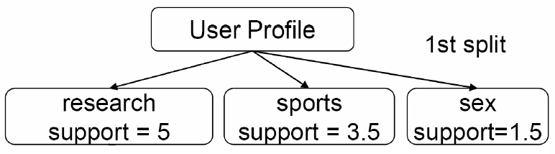
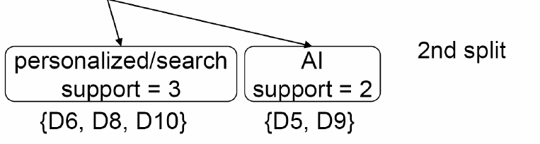
Building a Hierarchical User Profile
a_{i} | research | personalized | search | sports | AI | sex | …
weight | 5 | 3 | 3 | 3.5 | 2 | 1.5 | 0
Dik Lun Lee

Slide 34
Collaborative Filtering
Dik Lun Lee

Slide 35


Collaborative Filtering
People collaborate to make automatic predictions about the interests of a user by collecting related information from other users
Similar users are grouped together forming user communities
Important information identified among user communities are suggested to users within the same user community
Solving the Cold-Start problem in search engine personalization
  No suggestion can be provided to a new user with insufficient relevance feedback information (e.g. clickthroughs or browsed documents)
User 1
Query = “apple”
User 2
New User
Query = “apple”
Query = “apple”
……….
User n
Query = “apple”
Dik Lun Lee

Slide 36
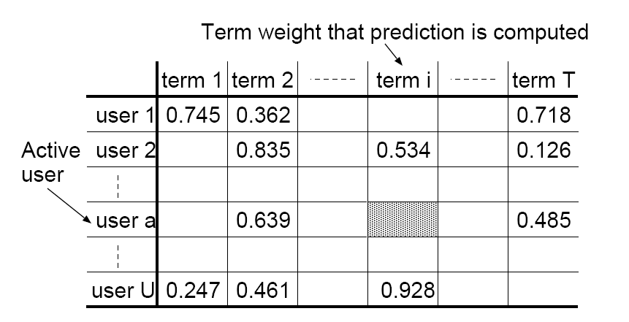
Collaborative Filtering
User profiling based on daily navigation history of users
For each user, different weights are assigned to the terms in the browsed documents
Identify k similar users
Predict missing term rating using a weighted combination from the k similar users
Dik Lun Lee

Slide 37
Collaborative Filtering
User 1
Query = “apple”
User 2
Query = “apple”
Similar
New User
User 3
Query = “apple”
Query = “apple”
User 4
Similar
Query = “apple”
……….
Similar
User n
Query = “apple”
Dik Lun Lee

